Slide 1
Measuring the Impact of Bot Accounts
on Political Network Polarization
Mert Ozer
Arizona State University

Slide 2
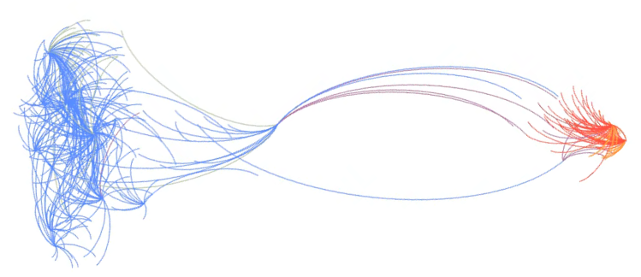
Random Walk Controversy Score
$$RWC=P_{LL^{+}}P_{RR^{+}} −P_{LR^{+}}P_{RL^{+}}$$
K. Garimella, G. De Francisci Morales, A. Gionis, and M. Mathioudakis,
“Quantifying controversy in social media,”
in Proceedings of the Ninth ACM International Conference on Web Search and Data Mining. ACM, 2016, pp. 33–42.

Slide 3
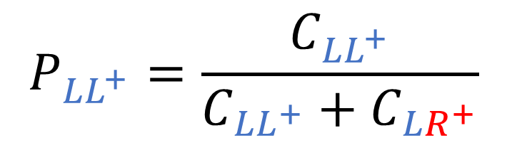
Random Walk Controversy Score
$$P_{LL^{+}}=\frac{C_{LL^{+}}}{C_{LL^{+}}+C_{LR^{+}}}$$
$$RWC=P_{LL^{+}}P_{RR^{+}} −P_{LR^{+}}P_{RL^{+}}$$
K. Garimella, G. De Francisci Morales, A. Gionis, and M. Mathioudakis,
“Quantifying controversy in social media,”
in Proceedings of the Ninth ACM International Conference on Web Search and Data Mining. ACM, 2016, pp. 33–42.

Slide 4
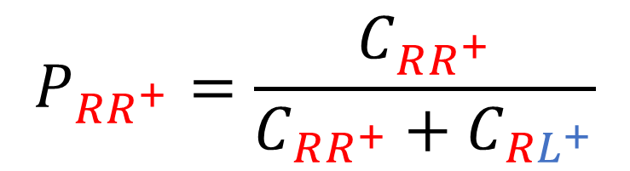
Random Walk Controversy Score
$$P_{RR^{+}}=\frac{C_{RR^{+}}}{C_{RR^{+}}+C_{RL^{+}}}$$
$$RWC=P_{LL^{+}}P_{RR^{+}} −P_{LR^{+}}P_{RL^{+}}$$
K. Garimella, G. De Francisci Morales, A. Gionis, and M. Mathioudakis,
“Quantifying controversy in social media,”
in Proceedings of the Ninth ACM International Conference on Web Search and Data Mining. ACM, 2016, pp. 33–42.

Slide 5
Random Walk Controversy Score
$$RWC=P_{LL^{+}}P_{RR^{+}} −P_{LR^{+}}P_{RL^{+}}$$
K. Garimella, G. De Francisci Morales, A. Gionis, and M. Mathioudakis,
“Quantifying controversy in social media,”
in Proceedings of the Ninth ACM International Conference on Web Search and Data Mining. ACM, 2016, pp. 33–42.

Slide 6
Existing nodes connect
ρ
polarWeight
ρ
polarWeight
New node comes
BOLLOBAS´ , B., BORGS, C., CHAYES, J. T., AND RIORDAN, O. 2003.
Directed scale-free graphs.
In ACM-SIAM Symposium on Discrete Algorithms. SIAM, Philadelphia, PA
Notes:
Preferential-attachment
Kolmogorov-Smirnov 2 sample test

Slide 7
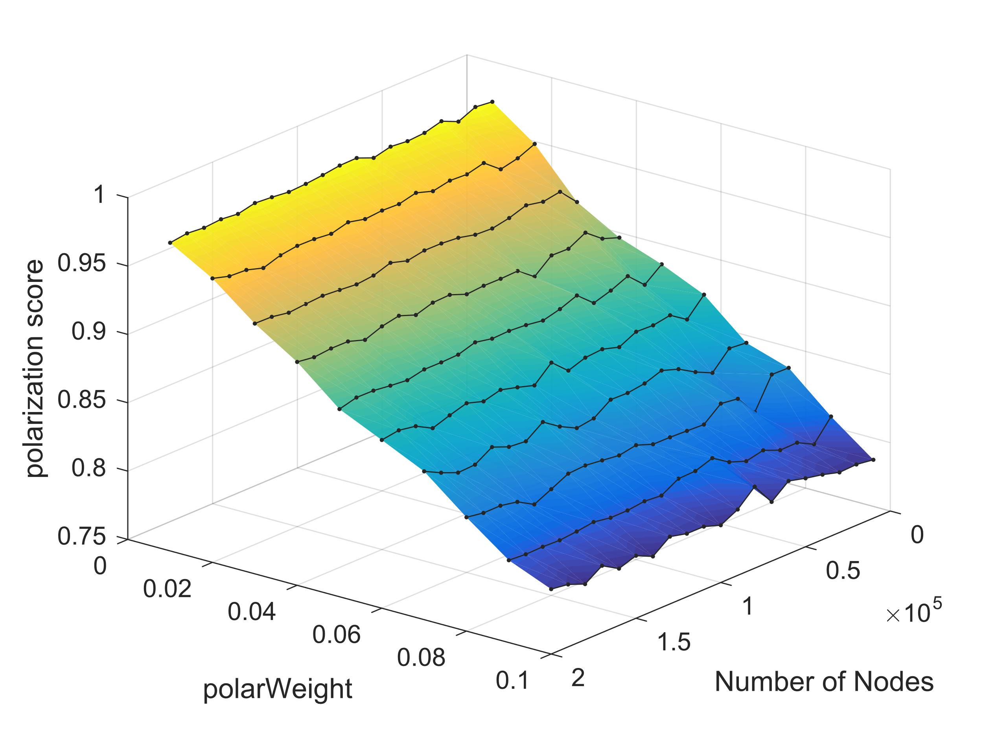
Existing nodes connect
ρ
polarWeight
ρ
polarWeight
New node comes
BOLLOBAS´ , B., BORGS, C., CHAYES, J. T., AND RIORDAN, O. 2003.
Directed scale-free graphs.
In ACM-SIAM Symposium on Discrete Algorithms. SIAM, Philadelphia, PA
Notes:
Preferential-attachment
Kolmogorov-Smirnov 2 sample test

Slide 8
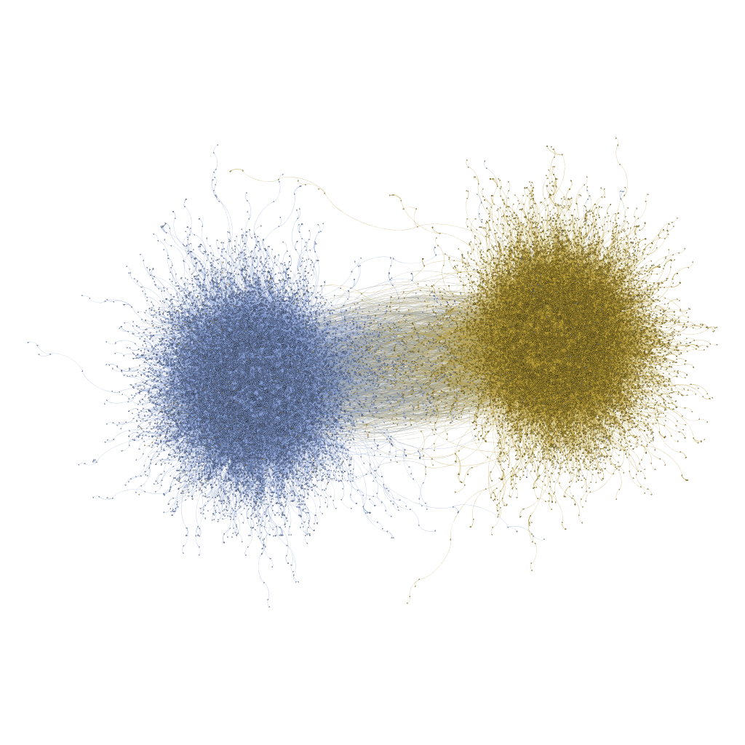
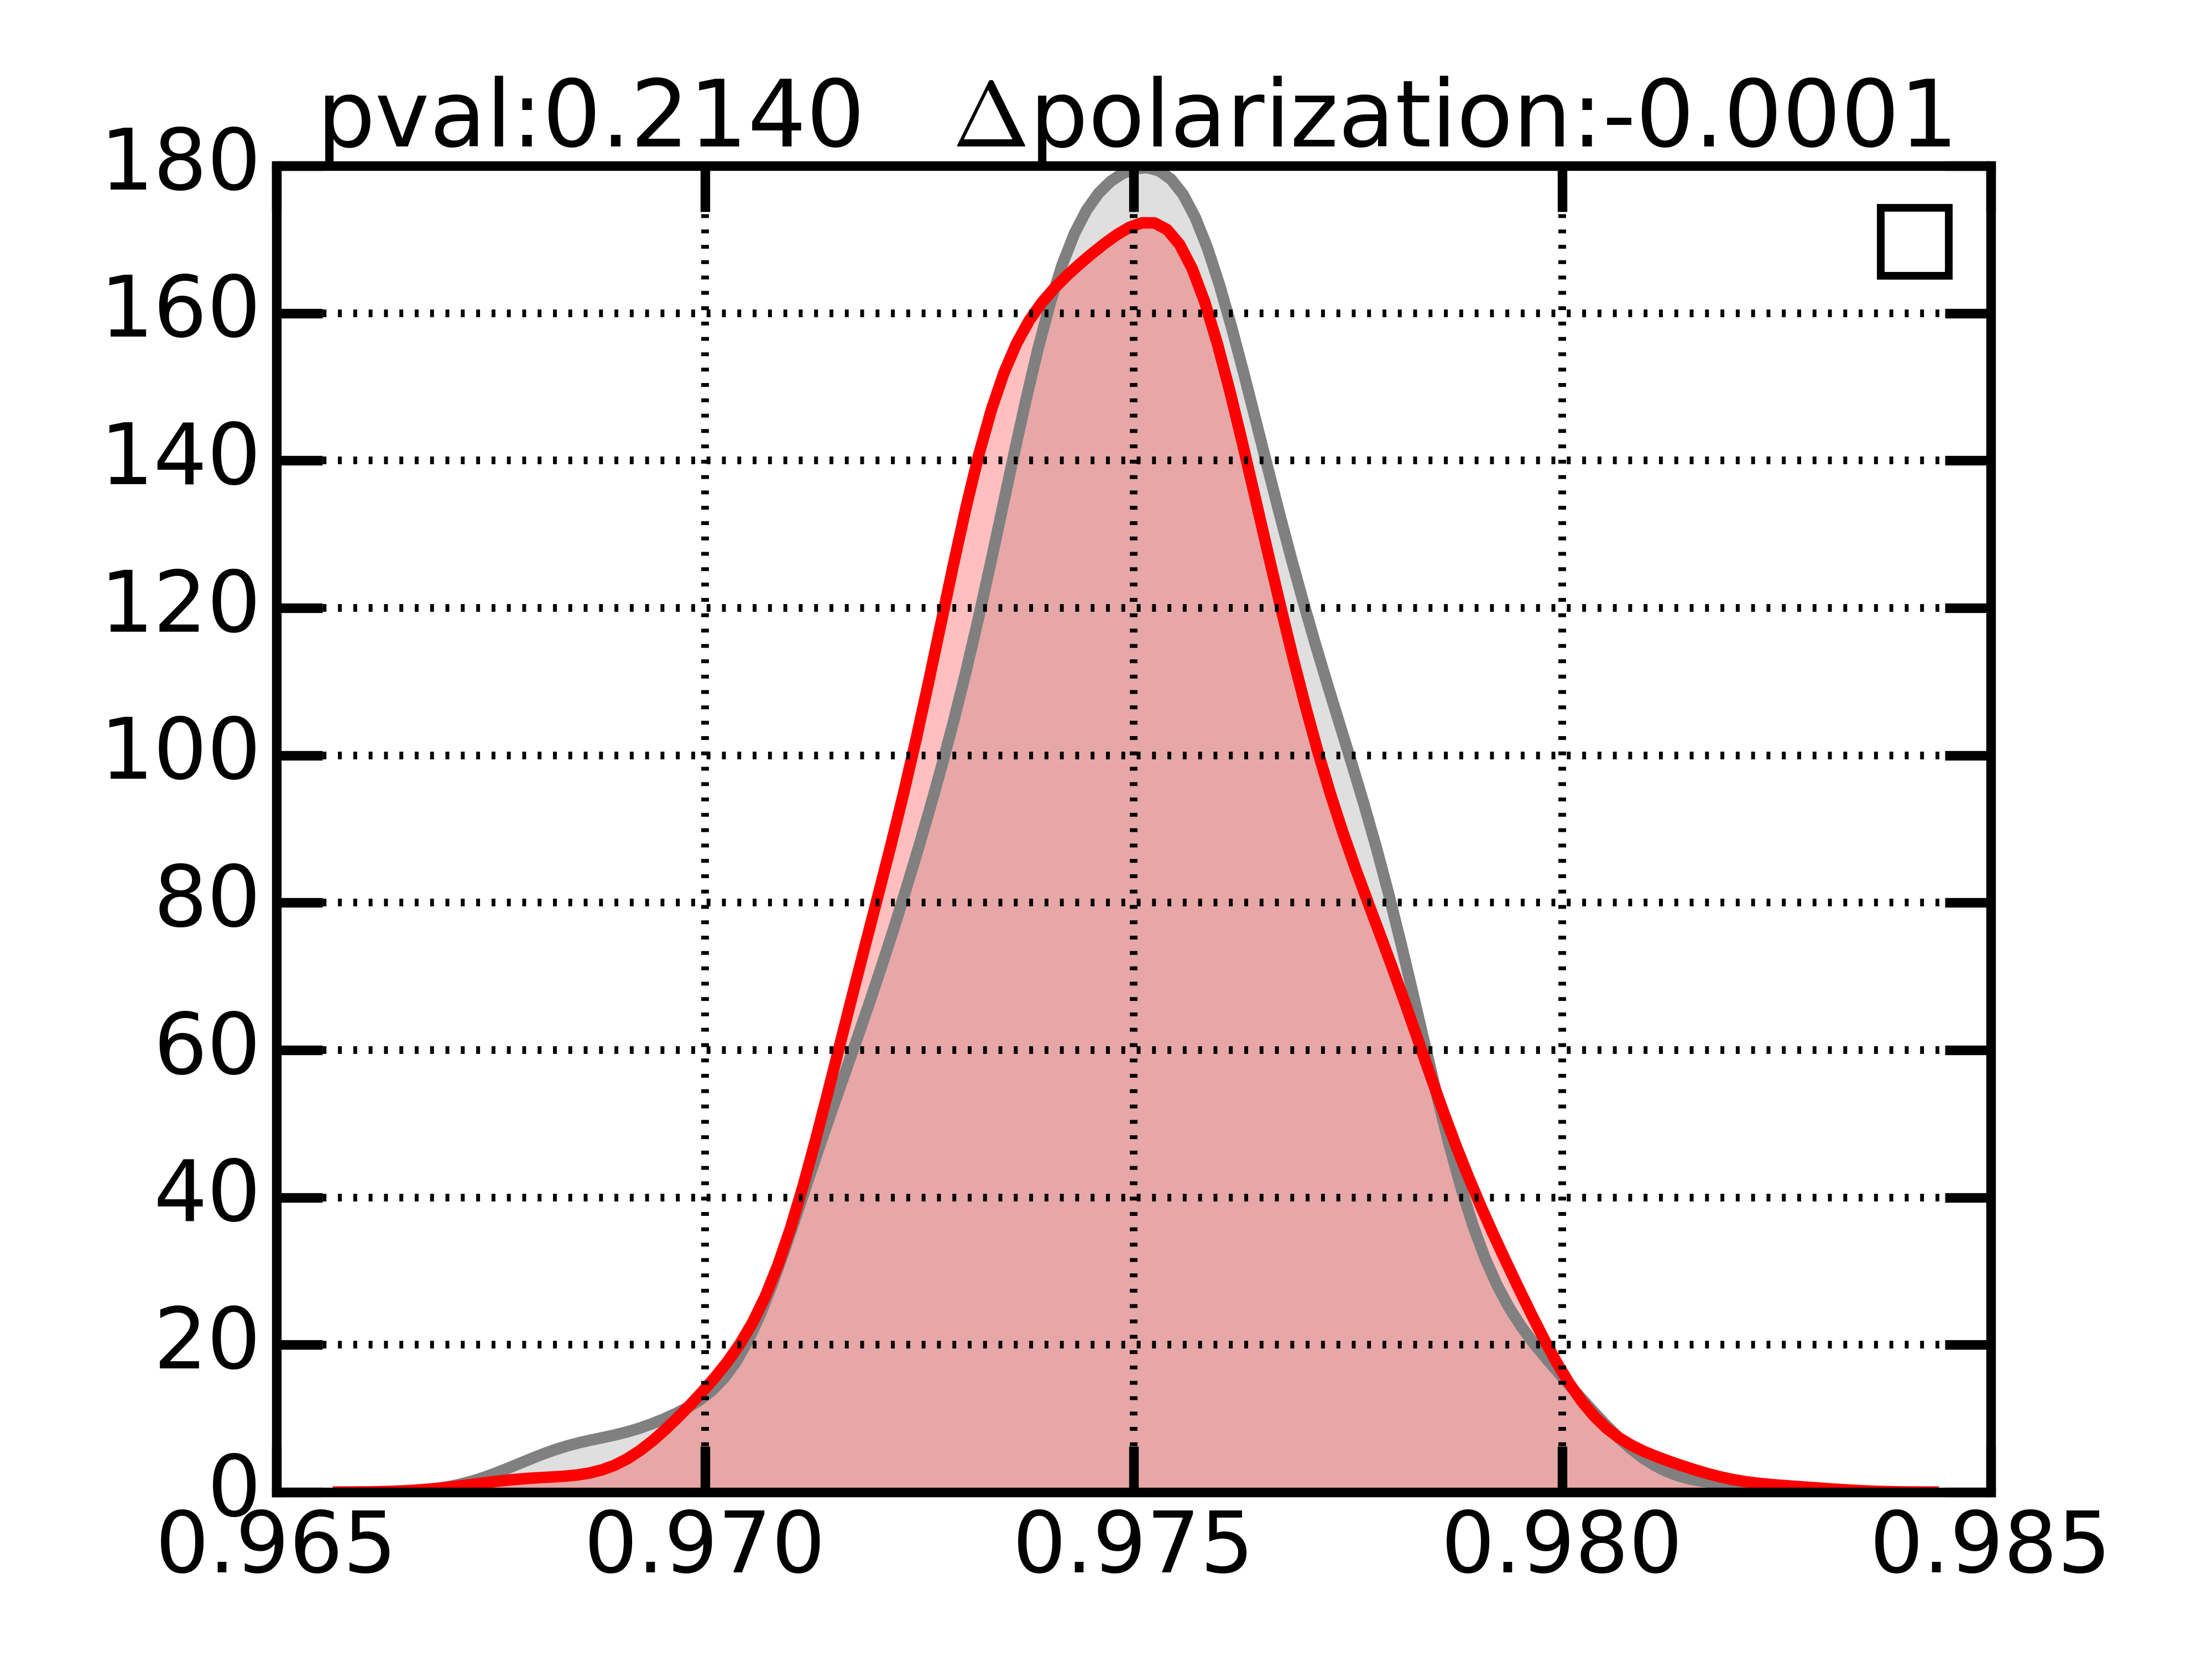
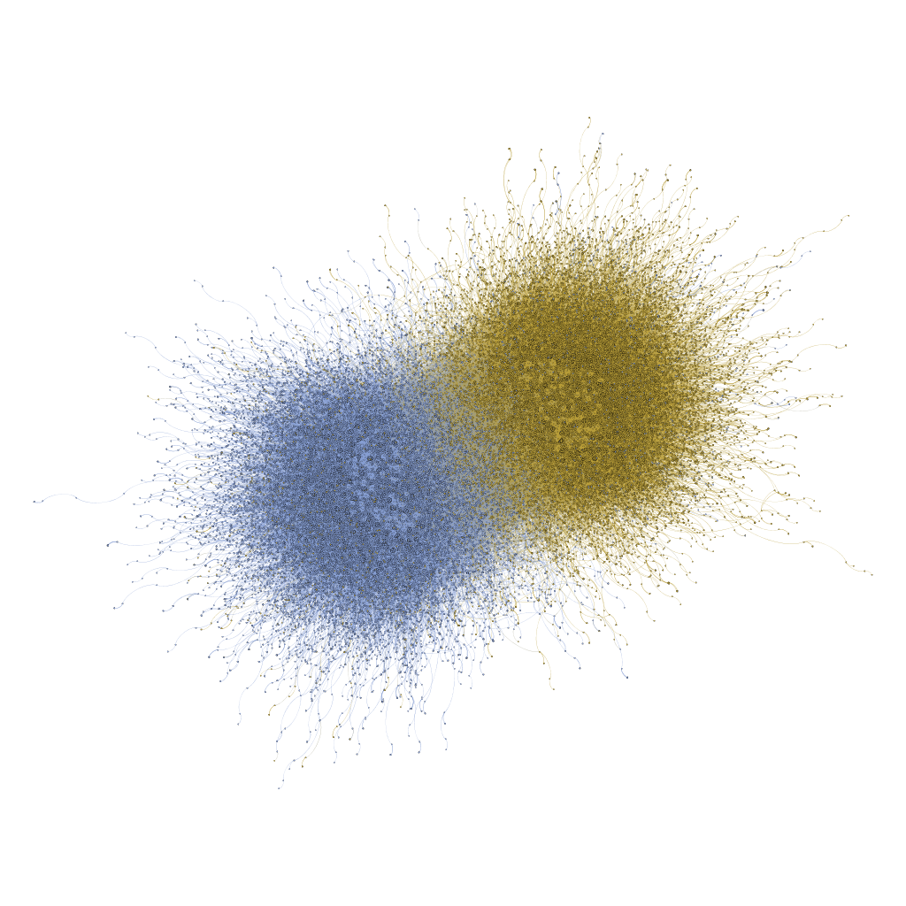
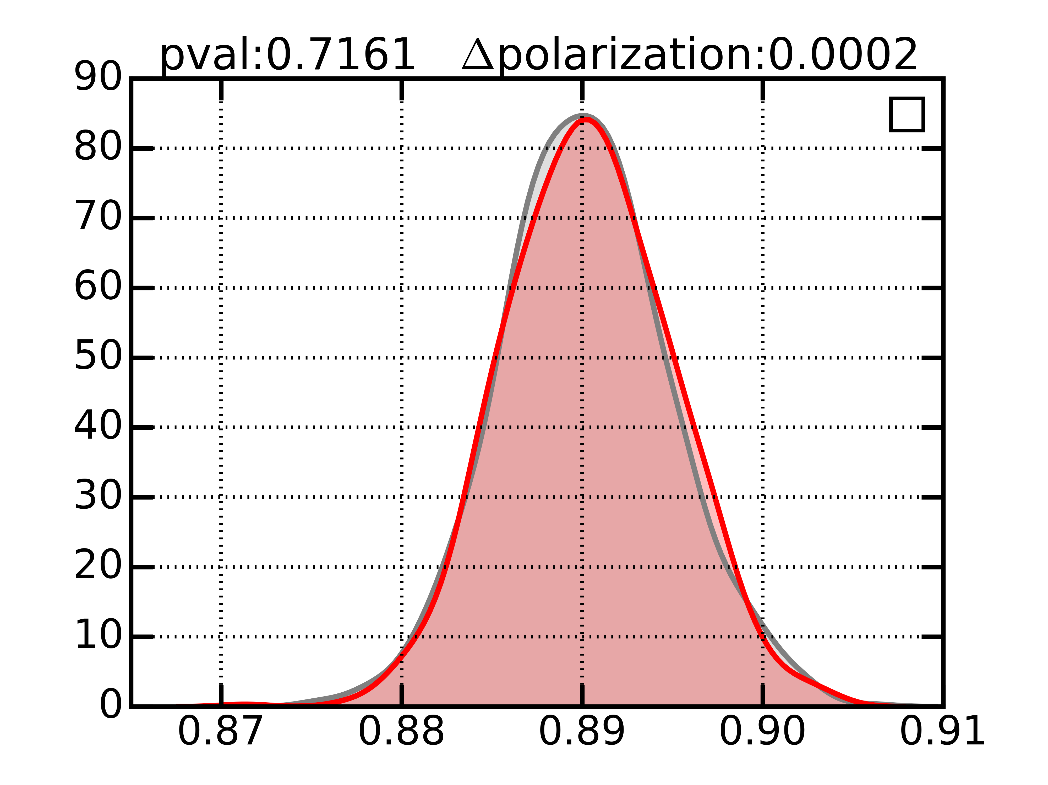
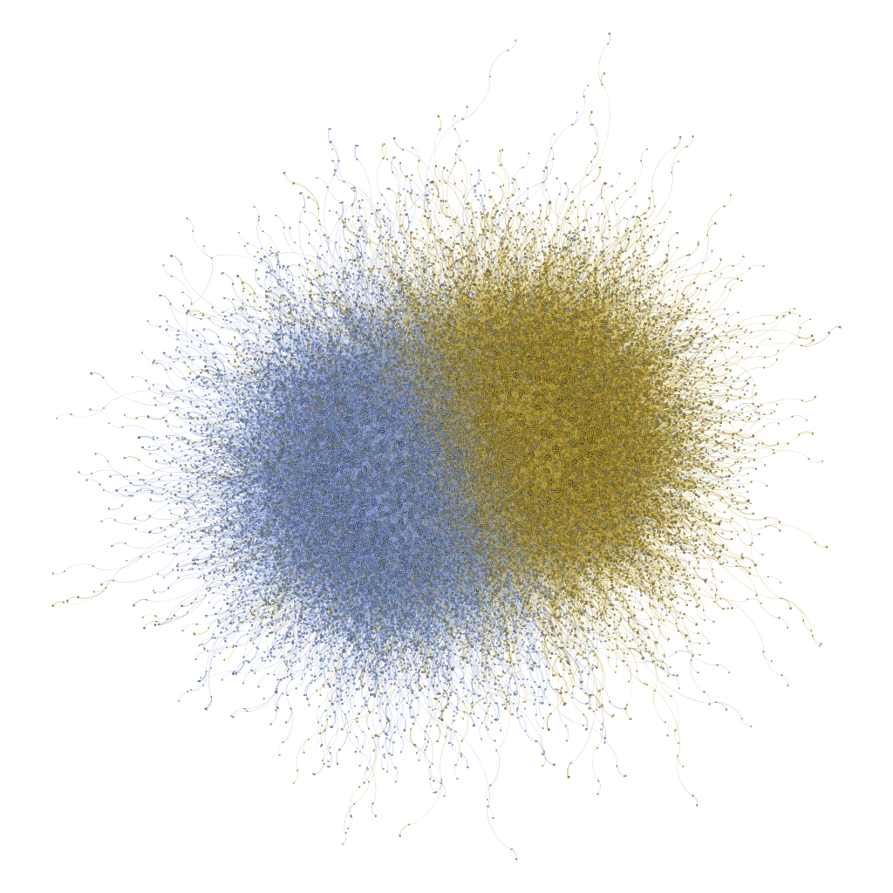
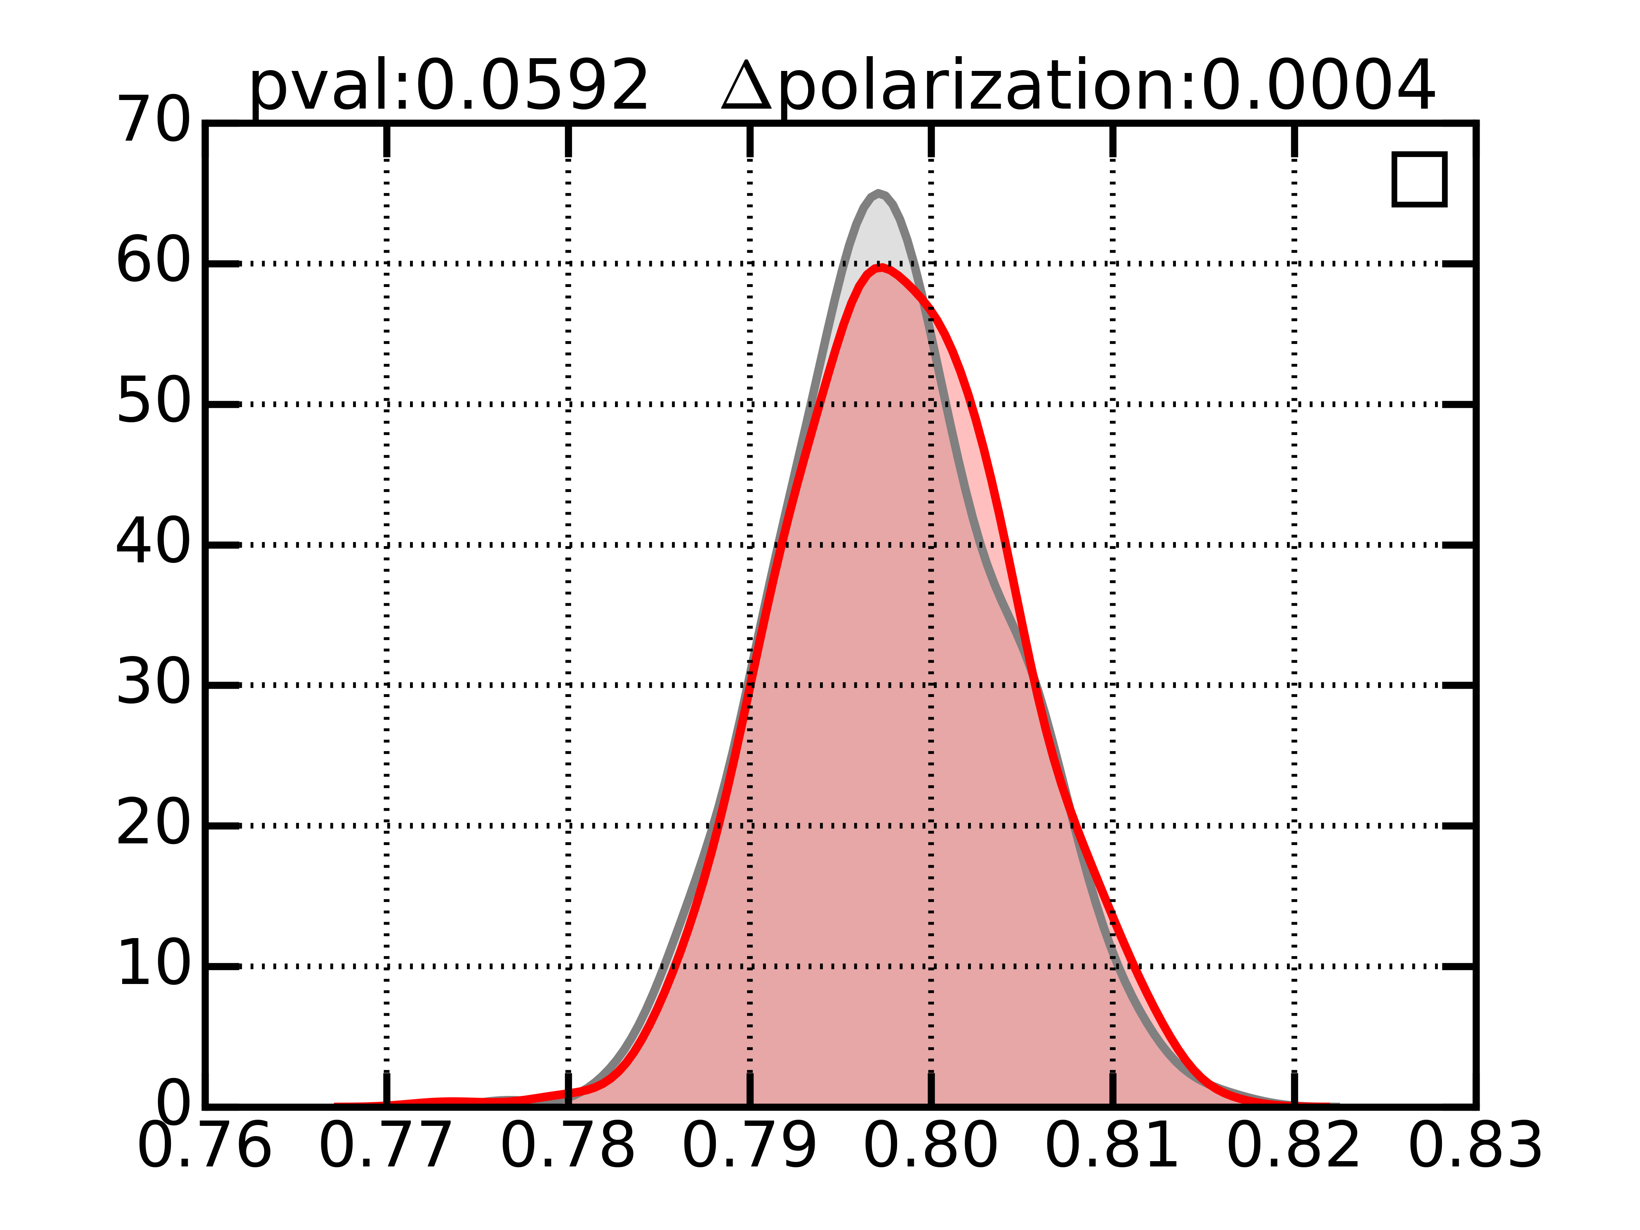
Existing nodes connect
ρ
polarWeight
Ρ = 0.01
ρ
polarWeight
New node comes
BOLLOBAS´ , B., BORGS, C., CHAYES, J. T., AND RIORDAN, O. 2003.
Directed scale-free graphs.
In ACM-SIAM Symposium on Discrete Algorithms. SIAM, Philadelphia, PA
Ρ = 0.05
Ρ = 0.1
Notes:
Preferential-attachment
Kolmogorov-Smirnov 2 sample test

Slide 9
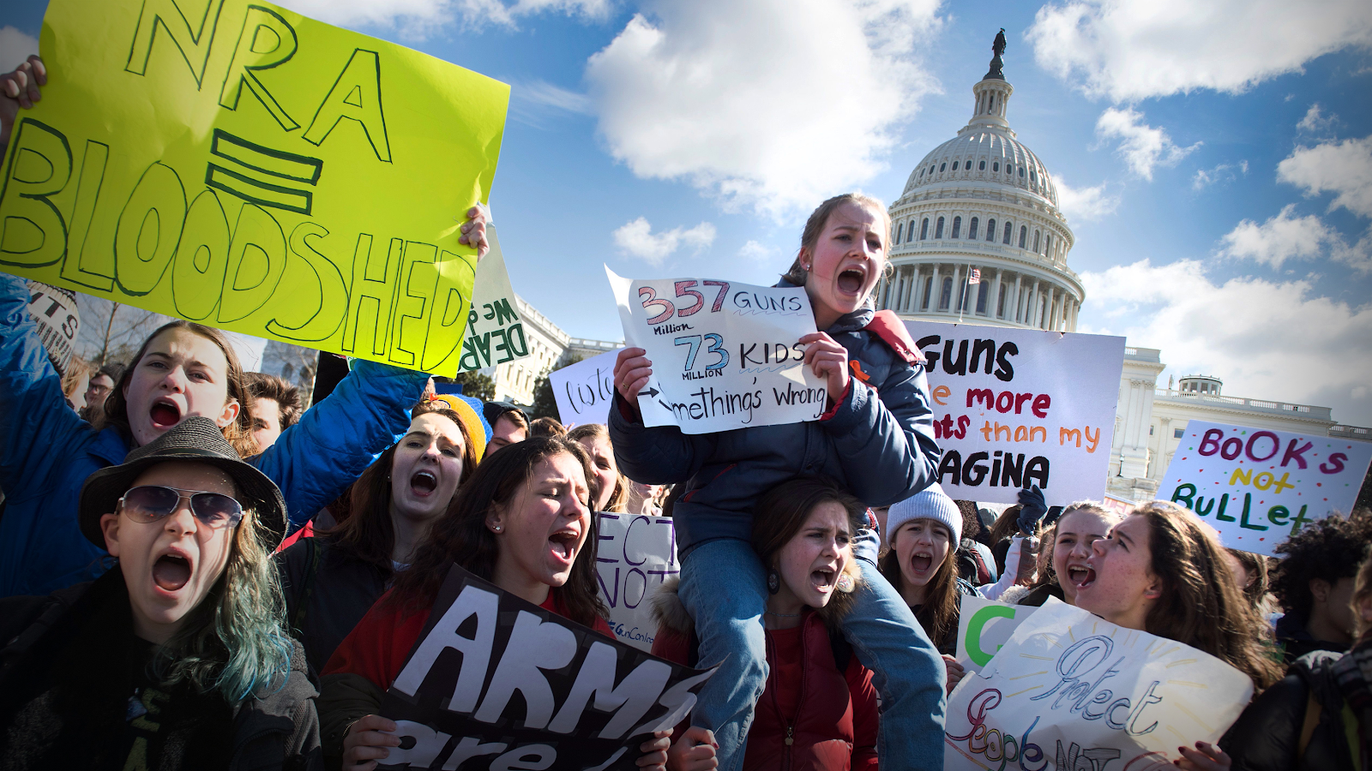

Slide 10


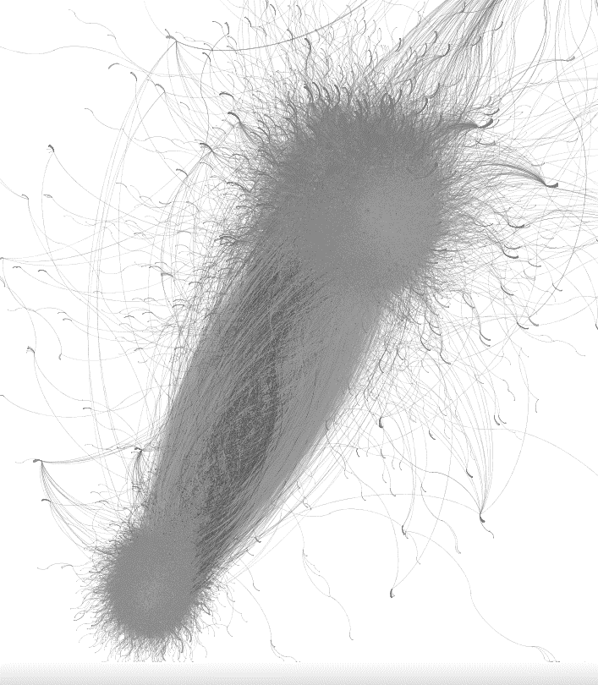

Data Collection & Preprocessing
25M tweets
3.7M users
Retweet Activity
Retweet Network
Notes:
140 keywords, hashtags, phrases purchased from GNIP

Slide 11



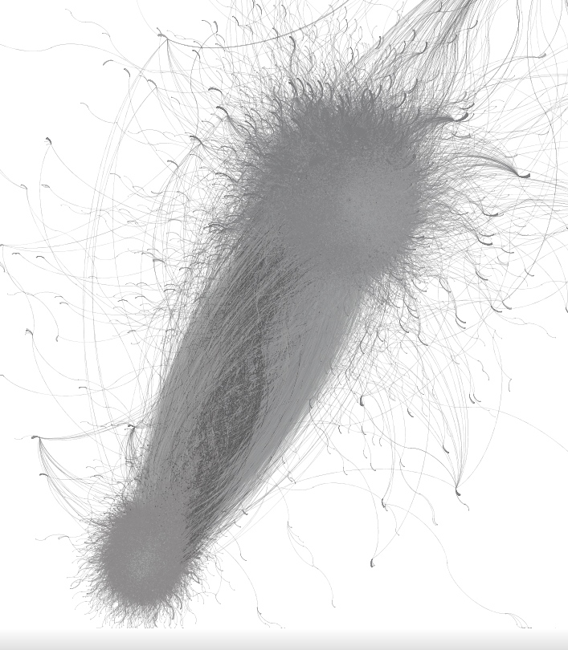
Data Collection & Preprocessing
50K labeled accounts
Label Propagation
 | Precision | Recall | F-1
Left | 0.98 | 0.99 | 0.98
Right | 0.96 | 0.90 | 0.93
25M tweets
3.7M users
Retweet Activity
Retweet Network
Notes:
140 keywords, hashtags, phrases purchased from GNIP

Slide 12

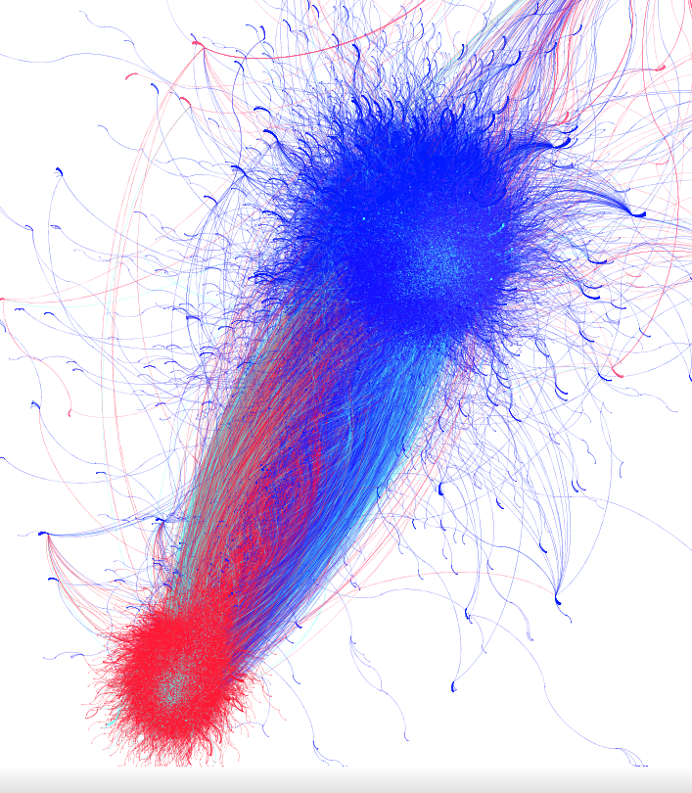
Data Collection & Preprocessing
50K labeled accounts
Label Propagation
 | Precision | Recall | F-1
Left | 0.98 | 0.99 | 0.98
Right | 0.96 | 0.90 | 0.93
25M tweets
3.7M users
Retweet Activity
Retweet Network
Notes:
140 keywords, hashtags, phrases purchased from GNIP
260K queried accounts
25K (~10%) bot accounts

Slide 13
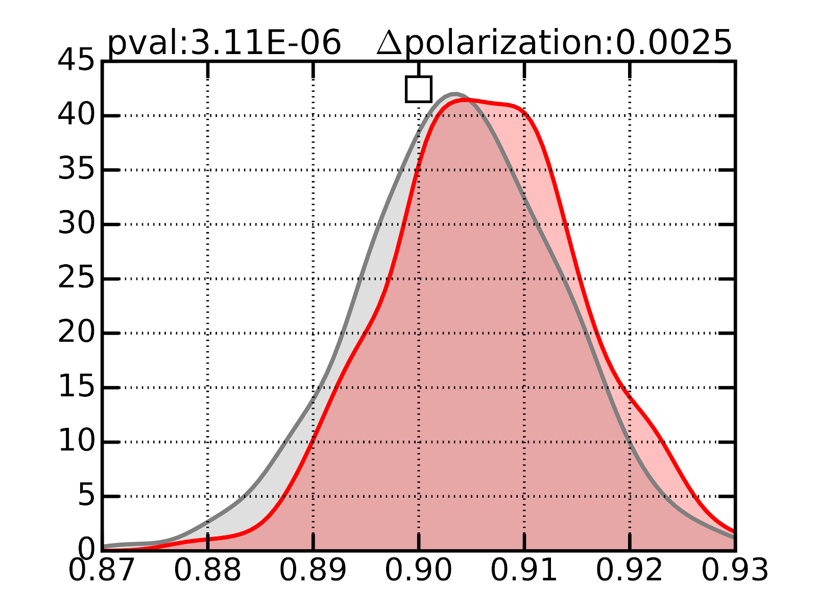
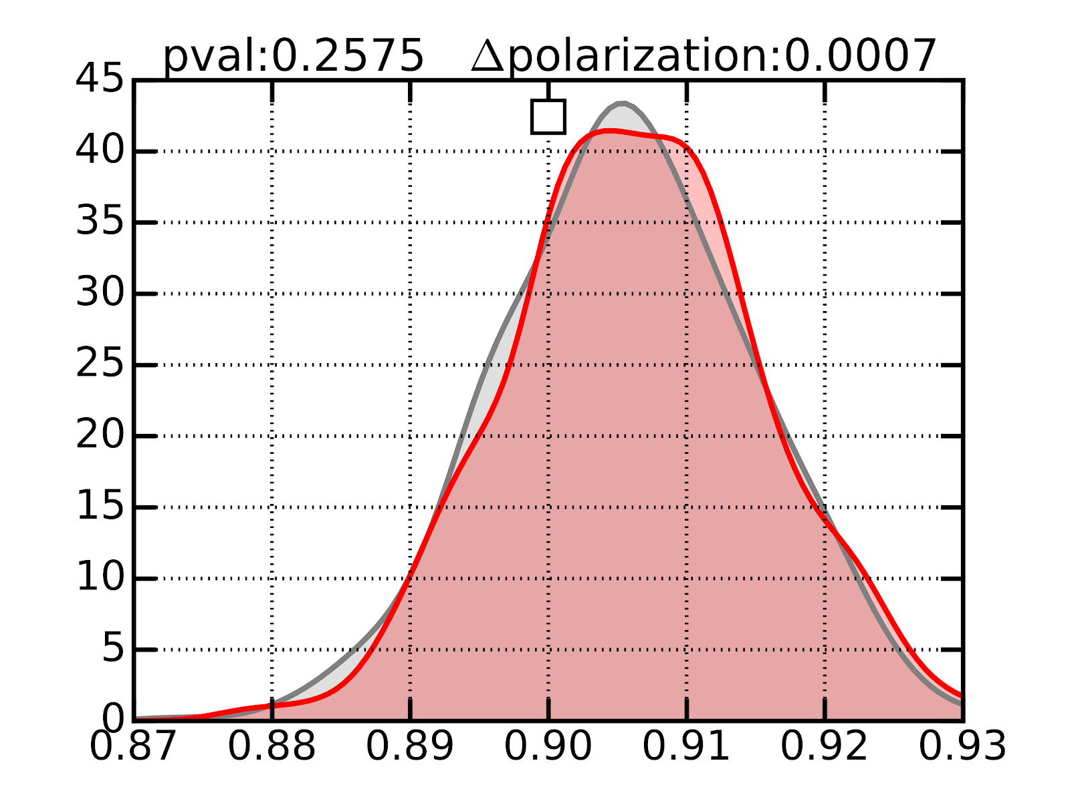
Bot Accounts’ Effect
Random Removal Effect
Complete RT Network
Complete RT Network
RT Network w/o Bots
RT Network w/o Random
Notes:
KS_2SampleTest
1000 sampling of polarization score.
10,000 times walk of 2000 steps(max).

Slide 14
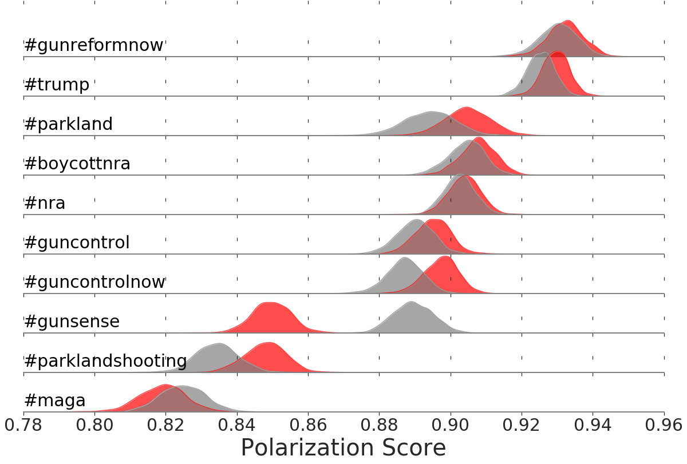
Bot Accounts’ Effect on Hashtags
Out of top 100 hashtags;
63 increase
10 no difference
27 decrease

Slide 15


Non-Bot and Bot Interactions
User Mention:
Quote:
1.5K
29K
82K
510K
1K
15K
13K
53K
Reply:
Retweet:
5K
160K
97K
1M
3K
85K
5K
123K

Slide 16
Non-Bot and Bot Interactions
User Mention:
Quote:
1.5K
29K
82K
510K
1K
15K
13K
53K
Reply:
Retweet:
5K
160K
97K
1M
3K
85K
5K
123K

Slide 17
What type of posts of bot accounts achieve higher RT engagement?
ZI Negative Binomial Regression On 100K Bot Generated Tweets | Incident Rate Ratios
Dependent Variables (***p < 0.0001) | IRR | Lower 95% | Upper 95%
url_count*** | 0.5522044 | 0.5350116 | 0.5699496
mention_count*** | 0.9830683 | 0.9776805 | 0.9884858
followers_count*** | 1.0000667 | 1.0000653 | 1.0000681
Emotional Only*** | 1.0762037 | 1.0588882 | 1.0938023
Moral-Emotional*** | 1.1104801 | 1.0741481 | 1.148041
Moral Only*** | 0.951206 | 0.9312959 | 0.9715419
media_count*** | 1.5962573 | 1.538831 | 1.6558266
we | 1.0027852 | 0.9726296 | 1.0338758
they*** | 1.1832946 | 1.1430972 | 1.2249056
Brady, W. J., Wills, J. A., Jost, J. T., Tucker, J. A. & Bavel, J. J. V. Emotion shapes the diffusion of moralized content in social networks PNAS (2017).
Suh, B., Hong, L., Pirolli, P., & Chi, E. Want to be retweeted? Large scale analytics on factors impacting retweet in Twitter network. SocialCom (2010).
Notes:
Emotional -> Fabulous, cry
moral-emotional -> Evil
Moral -> justice

Slide 18

When Self-Identified
@screen_name
Account Name
*_bot
* bot
bot_*
bot *
[a-z]+Bot
*_robot
* robot
robot_*
Robot *
[a-z]+Robot
*_chatbot
* chatbot
chatbot_*
chatbot *
[a-z]+Chatbot

Slide 19
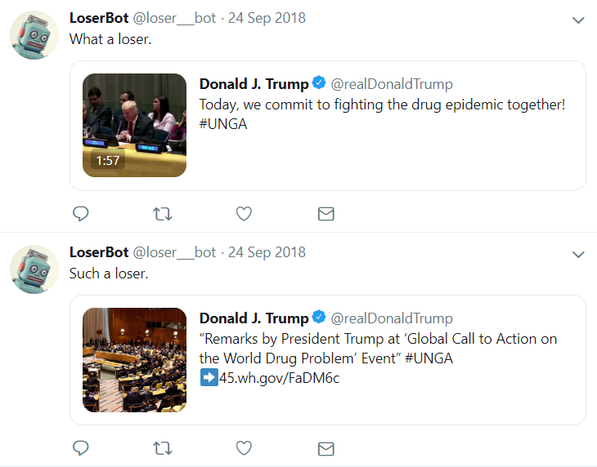
When Self-Identified
@screen_name
Account Name
*_bot
* bot
bot_*
bot *
[a-z]+Bot
*_robot
* robot
robot_*
Robot *
[a-z]+Robot
*_chatbot
* chatbot
chatbot_*
chatbot *
[a-z]+Chatbot

Slide 20
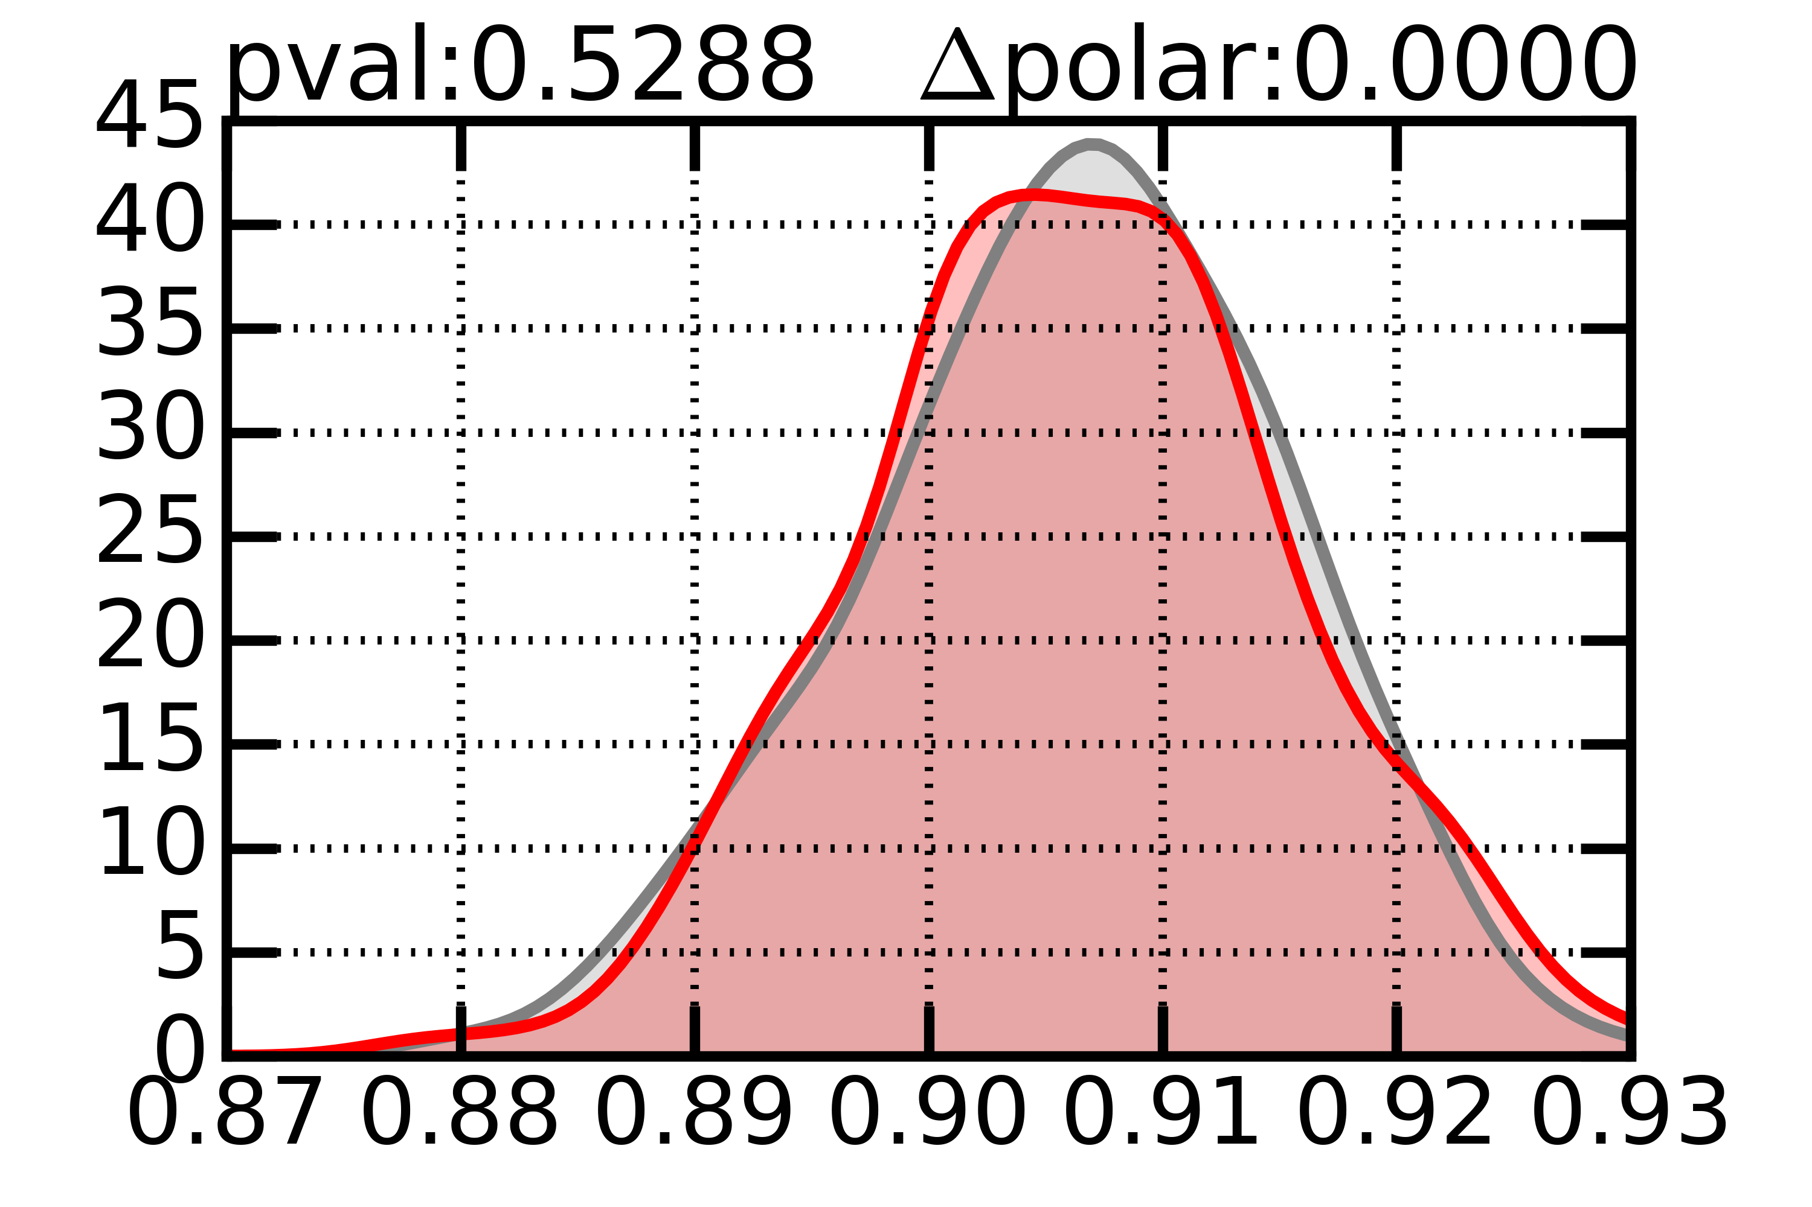
When Self-Identified
Complete RT Network
RT Network w/o Self Identified Bots
Notes:
2,261 accounts

Slide 21
When Self-Identified
User Mention:
Quote:
~0
309
82K
510K
~0
149
500
6K
Reply:
Retweet:
~0
1.5K
97K
1M
126
253
1K
13K
Notes:
2,261 accounts

Slide 22

Discussion & Future Steps
[D] Bot accounts appear to have contributed to the polarization of endorsement networks during the unfolding of Parkland Shooting incident more than randomly selected samples.
[D] Analysis of engaging content generated by bot accounts overlap with previous studies of general engaging content on social media.
[D] When a bot is self identified, the effect seems to be not measurable given the data;
Can a simple indicator (such as tick for verified accounts) alleviate the impact?
[F] May Botometer classifier be picking up correlates of polarizing accounts?
[F] Analyzing polarizing bot generated content against bridging ones.

Slide 23
Thank you!

